Slide 1
CA 7503 Software Testing

Slide 2
Lecture 1 : Software Testing Background

Slide 3
Motivation (1)
Why Software Testing?
The Lion King Animated Storybook, Fall 1994
Disney’s first multimedia CD-ROM game for children.
Sales were huge.
On December 26, Disney's customer support phones began to ring, and ring, and ring….from angry parents with crying children who couldn't get the software to work. Numerous stories appeared in newspapers and on TV news.
The software development team have tried their software on specific PC platforms. It failed on many very popular PC platforms!

Slide 4
Motivation (2)
Why Software Testing?
Intel Pentium Floating-Point Division Bug, 1994
Enter the following equation into your PC's calculator:
(4195835 / 3145727) * 3145727 - 4195835 If the answer is zero, your computer is just fine. If you get anything else, you have an old Intel Pentium CPU with a floating-point division bug, a software bug burned into a computer chip and reproduced over and over in the manufacturing process.
On October 30, 1994, Dr. Thomas R. Nicely of Lynchburg (Virginia) College traced an unexpected result from one of his experiments to an incorrect answer by a division problem solved on his Pentium PC. He posted his finding on the Internet and soon afterward a firestorm erupted as numerous other people duplicated his problem and found additional situations that resulted in wrong answers.
Fortunately, these cases were rare and resulted in wrong answers only for extremely math-intensive, scientific, and engineering calculations.

Slide 5
Motivation (3)
Why Software Testing?
NASA Mars Polar Lander, 1999
On December 3, 1999, NASA's Mars Polar Lander disappeared during its landing attempt on the Martian surface.
A Failure Review Board investigated the failure and determined that the most likely reason for the malfunction was the unexpected setting of a single data bit.
Most alarming was why the problem wasn't caught by internal tests.

Slide 6
Motivation (3)
In theory, the plan for landing was this: As the lander fell to the surface, it was to deploy a parachute to slow its descent.
A few seconds after the chute deployed, the probe’s three legs were to snap open and latch into position for landing. When the probe was about 1,800 meters from the surface, it was to release the parachute and ignite its landing thrusters to gently lower it the remaining distance to the ground.
To save money, NASA simplified the mechanism for determining when to shut off the thrusters. In lieu of costly radar used on other spacecraft, they put an inexpensive contact switch on the leg’s foot that set a bit in the computer commanding it to shut off the fuel. Simply, the engines would burn until the legs “touched down.”
Unfortunately, the Failure Review Board discovered in their tests that in most cases when the legs snapped open for landing, a mechanical vibration also tripped the touch-down switch, setting the fatal bit.
The result was catastrophic, but the reason behind it was simple.

Slide 7
Motivation (4)
Why Software Testing?
Malaysia Airlines jetliner, August 2005
As a Malaysia Airlines jetliner cruised from Perth, Australia, to Kuala Lumpur, Malaysia, it suddenly took on a mind of its own and zoomed 3,000 feet upward.
The captain disconnected the autopilot and pointed the Boeing 777’s nose down to avoid stalling, but was jerked into a steep dive. He controlled back sharply on both engines, trying to slow the plane. Instead, the jet raced into another climb.
The crew eventually regained control and manually flew their 177 passengers safely back to Australia.
Investigators quickly discovered the reason for the plane’s roller-coaster ride 38,000 feet above the Indian Ocean. A defective software program had provided incorrect data about the aircraft’s speed and acceleration, confusing flight computers. The computers had also failed, at first, to respond to the pilot’s commands.

Slide 8
What is a Bug?
Informally, it is “what happens when software fails”, whether the failure was
Inconvenient
Catastrophic
Terms for software failure
* Fault * Anomaly * Problem * Inconsistency
* Failure * Incident * Error * Feature
* Defect * Variance * Bug

Slide 9
What is a Bug?
Product Specification: “an agreement among the software development team. It defines the product they are creating, detailing what it will be, how it will act, what it will do, and what it won't do”
Formally, we say that a s/w bug occurs when one or more of the following five rules is true: when the software
doesn't do something that the product specification says it should do.
does something that the product specification says it shouldn't do.
does something that the product specification doesn't mention.
doesn't do something that the product specification doesn't mention but should.
is difficult to understand, hard to use, slow, or in the software tester's eyes will be viewed by the end user as just plain not right.

Slide 10
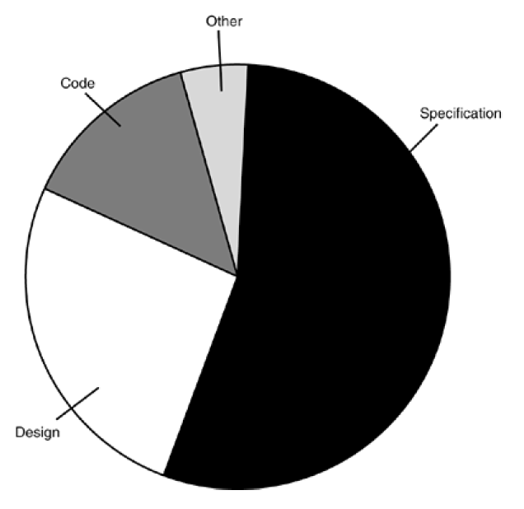
Why do Bugs Occur?
Bugs are caused for numerous reasons, but in this sample project analysis, the main cause can be traced to the specification.

Slide 11
Symptoms and Root Causes of Bugs
Inaccurate understanding of end user needs
Inability to deal with changing requirements
Modules that don’t fit together
Software that is hard to maintain or extend
Late discovery of serious project flows
Poor software quality
Unacceptable software performance
Team members in each other’s way, making it impossible to reconstruct who changed what, when, where and why
An untrustworthy build-and-release process

Slide 12
Root Causes of Project Failures
Ad hoc requirement management
Ambiguous and imprecise communication
Brittle (Fragile) architectures
Overwhelming complexity
Undetected inconsistencies in requirement, design, and implementation
Insufficient testing
Subjective assessment of project status
Failure to attack risk
Uncontrolled change propagation
Insufficient automation

Slide 13
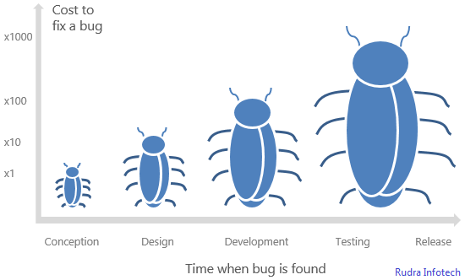
The Cost of Bugs
Remember Disney’s Lion King CD!

Slide 14
What does a Software Tester Do?
The goal of a software tester is to
find bugs
find bugs and find them as early as possible
find bugs, find them as early as possible, and make sure they get fixed

Slide 15
What Makes a Good Software Tester?
They are explorers.
They are troubleshooters. They love puzzles.
They are relentless. Software testers keep trying.
They are creative.
They are (mellowed) perfectionists.
They exercise good judgment.
They are tactful and diplomatic.
They are convincing.
Software Testing is Fun ☺

Slide 16
What is Software Testing?
Software testing is a process of executing a program or application with the intent of finding the software bugs.
It can also be stated as the process of validating and verifying that a software program or application or product: Meets the business and technical requirements that guided it's design and development.

Slide 17
What is Software Testing?
Testing software typically involves:
Executing software with inputs representative of actual operation conditions (or operational profiles )
Comparing produced/expected outputs
Comparing resulting/expected states
Measuring execution characteristics (e.g., memory used, time consumed, etc.)

Slide 18
Terminology
Fault: an imperfection that may lead to a failure
E.g., missing/incorrect code that may result in a failure
Bug: another name for a fault in code
Error: where the system state is incorrect but may not have been observed
Failure: some failure to deliver the expected service that is observable to the user

Slide 19
A few more definitions
Test Case: set of inputs, execution conditions, and expected results developed for a particular objective
Test Suite: collection of test cases, typically related by a testing goal or an implementation dependency
Test Driver: class or utility program that applies test cases
Test harness: system of test drivers and other tools that support test execution.
Test Strategy: algorithm or heuristic to create test cases from a representation, implementation, or a test model.
Oracle: means to check the output from a program is correct for the given input.
Stub: partial temporary implementation of a component (usually required for a component to operate)

Slide 20
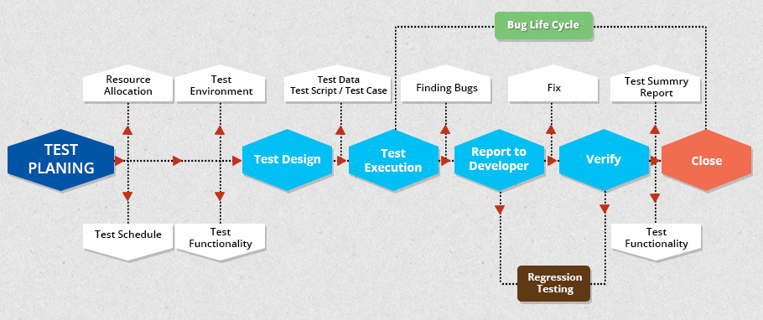
A Software Testing Process

